Slide 1

PERFUME MANAGEMENT SYSTEM
Complete Business Solution for Perfume Retail Shops
Best Programming Practices And Design Patterns

Slide 2
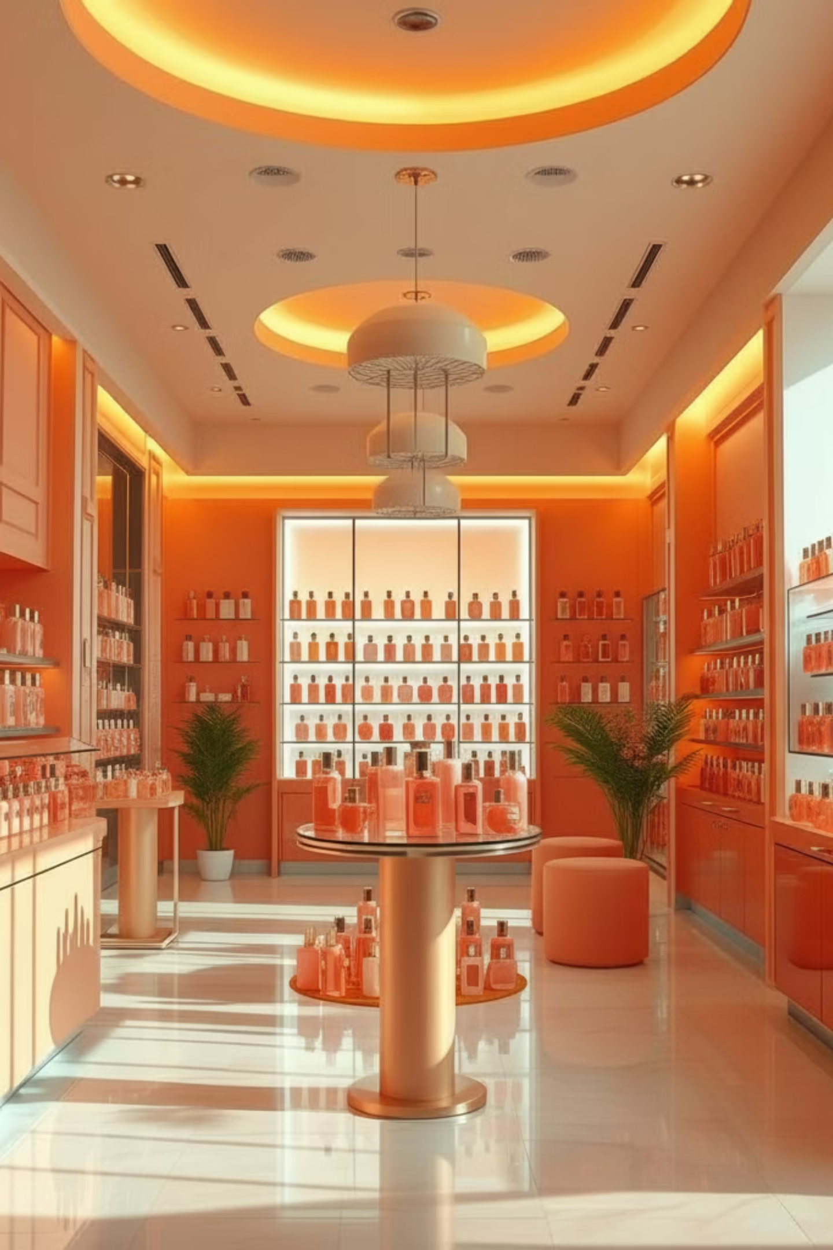
Project Overview: Perfume Management System
The Perfume Management System is a comprehensive web-based application meticulously designed to manage all facets of a perfume retail business. It aims to modernise operations, from inventory to sales, ensuring efficiency and customer satisfaction.
1
2
Streamlined Operations
Enhanced Insights
Automate inventory management, sales processing, and customer loyalty programmes for enhanced efficiency.
Generate critical business reports, monitor stock levels, and receive expiry alerts for proactive decision-making.
3
Targeted Audience
Designed for shop owners/managers, sales staff, and customers participating in loyalty programmes.
Built on a robust web-based platform, the system supports real-time inventory updates, barcode scanning, and an automated alerting system.

Slide 3

Addressing Current Challenges in Perfume Retail
Perfume retail shops often face significant operational hurdles that impact profitability and customer experience. Our system directly tackles these prevalent issues.
❌ Manual Inventory Tracking
Traditional methods are prone to errors, time-consuming stock counts, and lack real-time visibility, leading to inefficiencies and potential losses.
❌ Lost Sales & Expired Products
Without timely alerts for low stock, sales opportunities are missed. Similarly, products expiring unnoticed result in waste and financial loss.
❌ Poor Customer Retention
The absence of effective loyalty programmes means customers are less likely to return, impacting long-term revenue and brand loyalty.
❌ Limited Business Insights
Lack of detailed sales analytics makes data-driven decision-making difficult, hindering strategic growth and operational improvements.

Slide 4
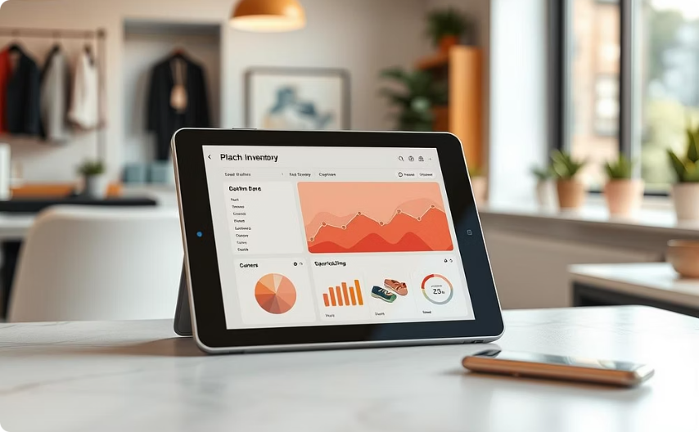


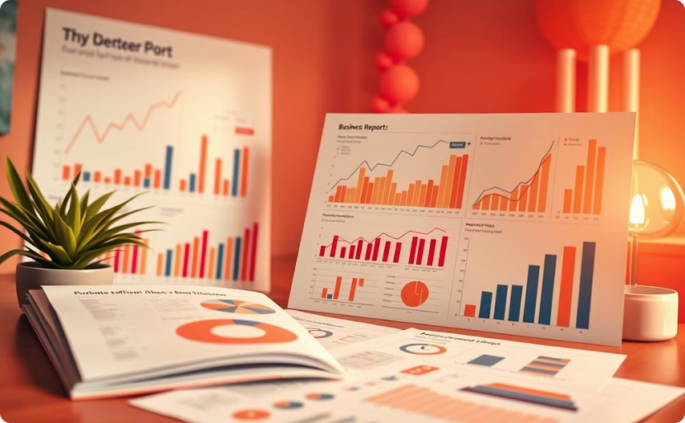

Our Proposed Solution: A Smart, Integrated Approach
The Perfume Management System offers a comprehensive solution to the challenges faced by retail shops, integrating automation and intelligence for optimal operations.
✅ Automated Inventory
✅ Smart Alert System
✅ Customer Loyalty
✅ Comprehensive Reporting
Enjoy real-time stock tracking, barcode scanning, and automatic updates post-sale to minimise errors and maximise accuracy.
Receive proactive notifications for low stock and expiry dates, enabling timely action and preventing losses.
Implement a robust loyalty programme where customers earn and redeem points, fostering repeat business and stronger relationships.
Access detailed daily and monthly sales reports, profit analysis, and key performance metrics to guide strategic decisions.
✅ Role-Based Access
Ensure secure and organised operations with distinct access levels for administrators and sales staff, maintaining data integrity.

Slide 5
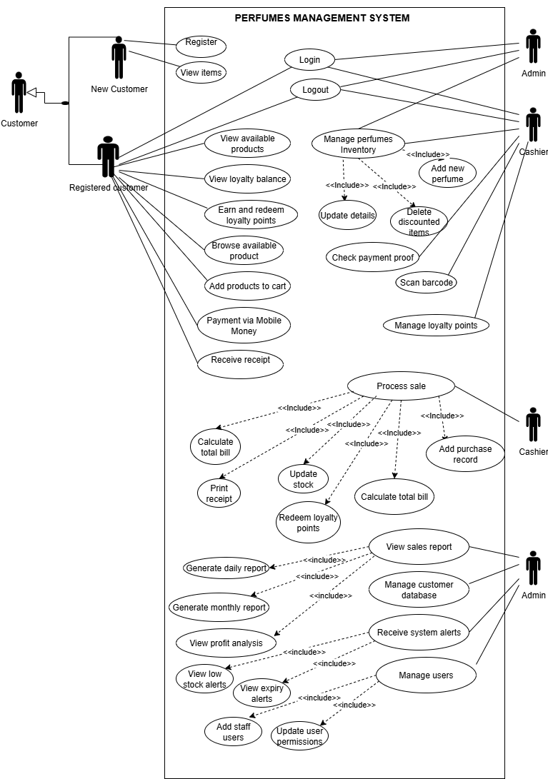
USE CASE DIAGRAM

Slide 6
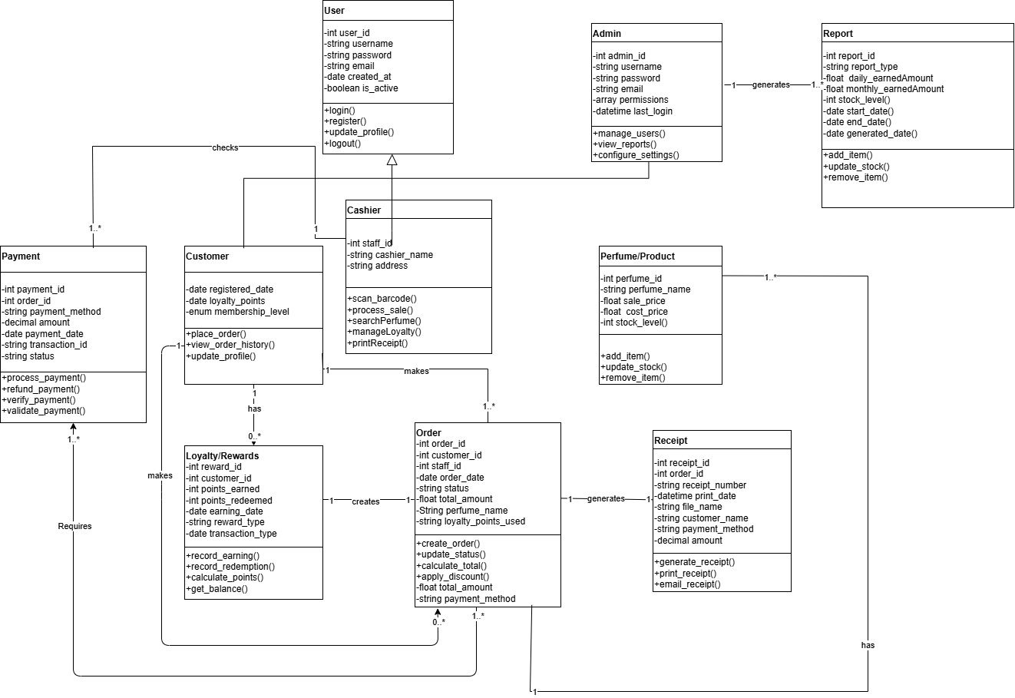
CLASS DIAGRAM

Slide 7
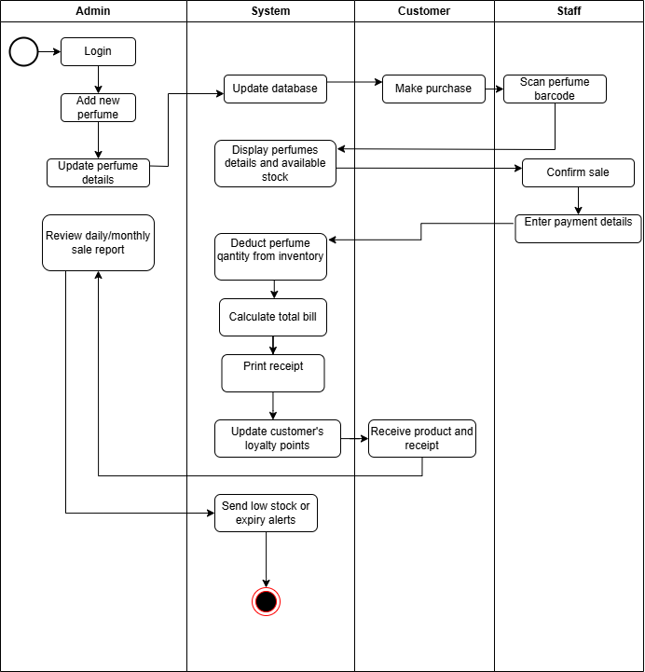
PERFUMES MANAGEMENT SYSTEM
ACTIVITY DIAGRAM

Slide 8
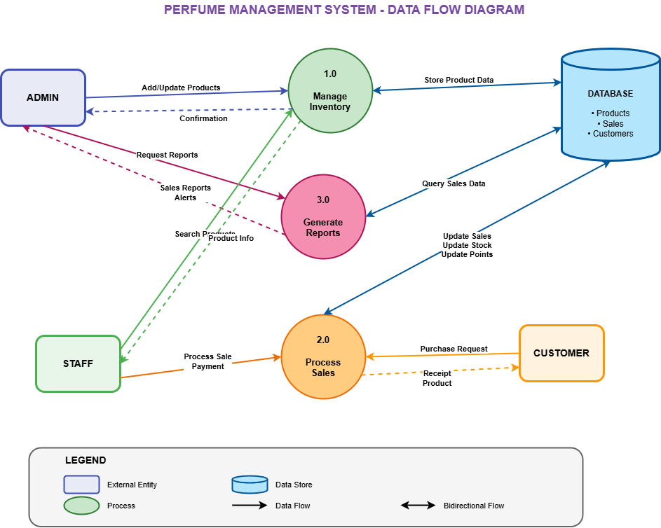
DATA FLOW DIAGRAM

Slide 9
System Architecture: Three-Tiered Design
Our system is built upon a robust and scalable three-tier architecture, ensuring separation of concerns, flexibility, and maintainability.
1. Presentation Layer (Frontend)
2. Business Logic Layer (Backend)
3. Data Layer (Database)
Securely stores and retrieves all critical business data.
This layer is the user-facing interface, crafted for intuitive interaction.
The core of the system, handling all processing and operations.
Users, permissions, & perfume inventory
Web-based user interface
Sales processing & inventory management
Sales records, customer data, & alerts
Responsive design for all devices
Robust and reliable data storage
Role-based dashboards for tailored views
Loyalty calculations & report generation
Alert monitoring for critical events
With the help of HTML, CSS, JavaScript and PHP languages.

Slide 10
Functional & Non-Functional Requirements
Our system is designed to meet precise functional capabilities and robust quality attributes, ensuring a reliable and user-friendly experience.
Functional Requirements
Non-Functional Requirements
These define what the system *must do*.
These define how well the system performs its functions.
FR1: Authentication & Authorization: Secure login and role-based access.
Performance: Response time < 2 seconds, support 10+ concurrent users.
FR2: Inventory Management: Full CRUD operations for perfumes with real-time tracking.
Security: Encrypted passwords, session timeouts, role-based access, audit logging.
FR3: Sales Processing: Efficient transaction handling, multiple payments, auto stock deduction, receipt generation.
Reliability: 99% uptime, atomic transactions, daily backups.
Usability: Intuitive UI, minimal training, clear error messages, max 3 clicks for core functions.
FR4: Loyalty Management: Automatic points calculation, redemption, and purchase history tracking.
Scalability: Handle 10,000+ products, 100,000+ sales, 50,000+ customers.
FR5: Reporting: Comprehensive sales, profit, and performance reports with visualisations.
FR6: Alert System: Automated notifications for low stock and expiry dates.

Slide 11



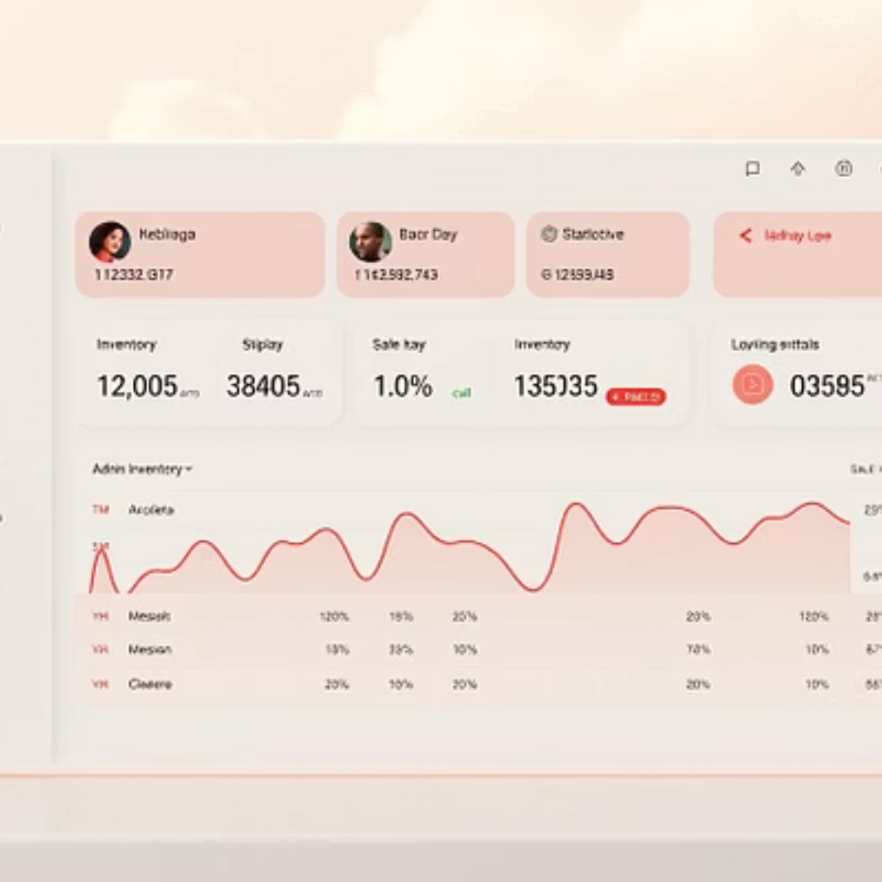
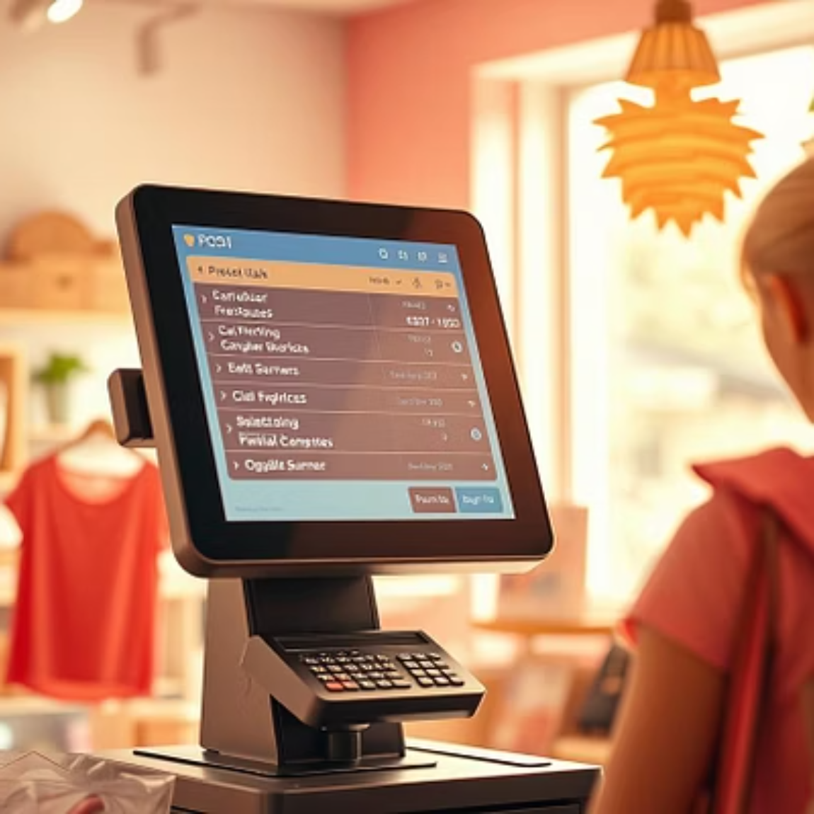
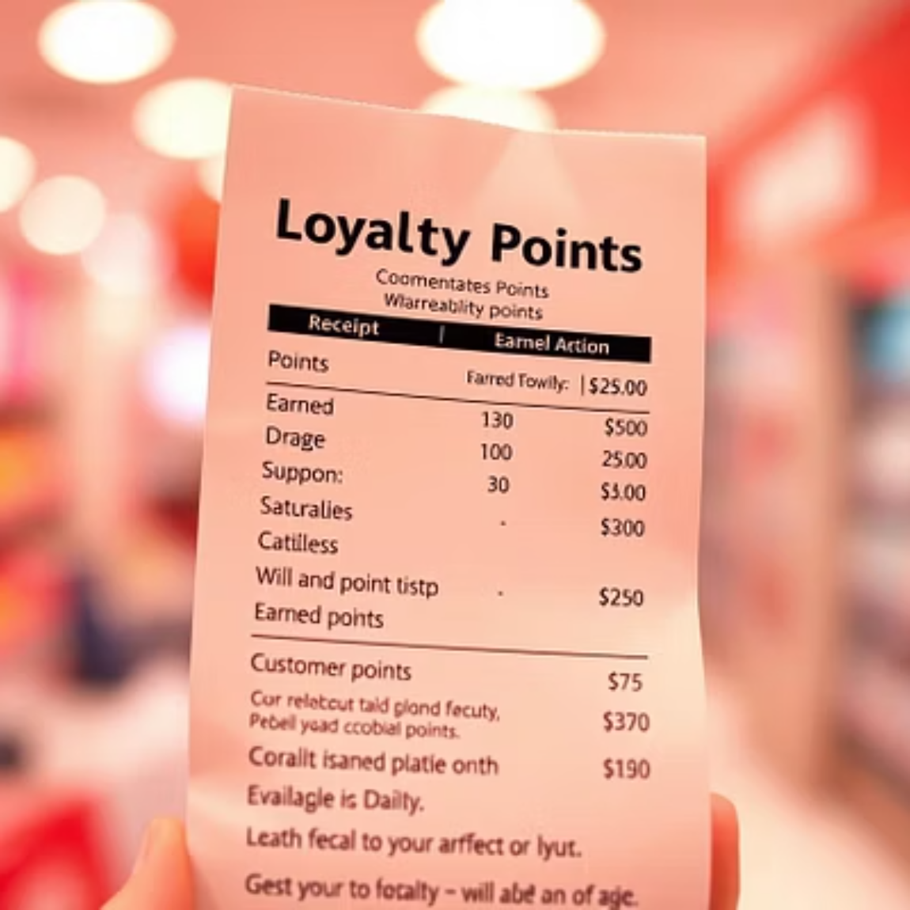
Key Features: Empowering Admins, Staff, and Customers
Our Perfume Management System offers tailored functionalities to enhance the experience for every user group.
Admin Dashboard
Sales Staff Dashboard
Customer Benefits
Comprehensive tools for Inventory Management, detailed Business Reports, proactive Alert Monitoring, and efficient User Management.
Efficient Sales Processing, seamless Loyalty Management, and professional Receipt Printing.
Enjoy Fast Checkout, rewarding Loyalty Rewards, clear Professional Online Receipts, and a more personalised Service Experience.

Slide 12
Benefits & Future Enhancements
Our system delivers tangible value to all stakeholders and is designed with future growth in mind.
Business Benefits & ROI
Future Enhancements
Increased Revenue
Building on our strong foundation, we envision exciting future capabilities:
Maximize sales opportunities.
Reduced Operational Costs
AI-Powered Analytics
Minimize waste and streamline processes.
Predictive inventory and sales forecasting.
Data-Driven Decisions
Mobile Application
Empower strategic planning.
POS and remote management via apps.
Enhanced Customer Loyalty
E-Commerce Integration
Loyalty programs improve retention.
Seamless omnichannel experience.
Multi-Branch Support
Centralized management for multiple locations.

Slide 13


Thank You!
MUGENI Cynthia
Lead System Designer
https://www.linkedin.com/in/mugeni-cynthia-10211834b/
https://github.com/M26600

